Slide 1
Docker Basics
Vraj Suratwala
MSA
Department of ICT, VNSGU

Slide 2
What is Docker?
Docker is a lightweight platform used to containerize, package, ship, and run applications along with all their required dependencies.
For example, instead of installing:
Application
Python
Libraries
Configuration
Database dependencies
separately on every computer, Docker packages the required environment into a Docker image, which is then used to create a container.

Slide 3
Why Docker?
Suppose a developer creates an application on their computer:
Developer Machine
Application
Python 3.x
Library A
Library B
Configuration
It works on the developer's machine but fails on another machine because of different versions or missing dependencies.
So what is the Solution ?

Slide 4
Why Docker ?
Docker solves this by packaging the application and its dependencies together:
Docker Image
├── Application
├── Dependencies
├── Libraries
└── Configuration
↓
Container
↓
Runs anywhere
This provides consistency between:
Development
Testing
Production
Cloud environments

Slide 5
Important Docker Terms
There are four important terms you should remember:
Docker Image
Docker Container
Docker Engine
Docker Registry

Slide 6
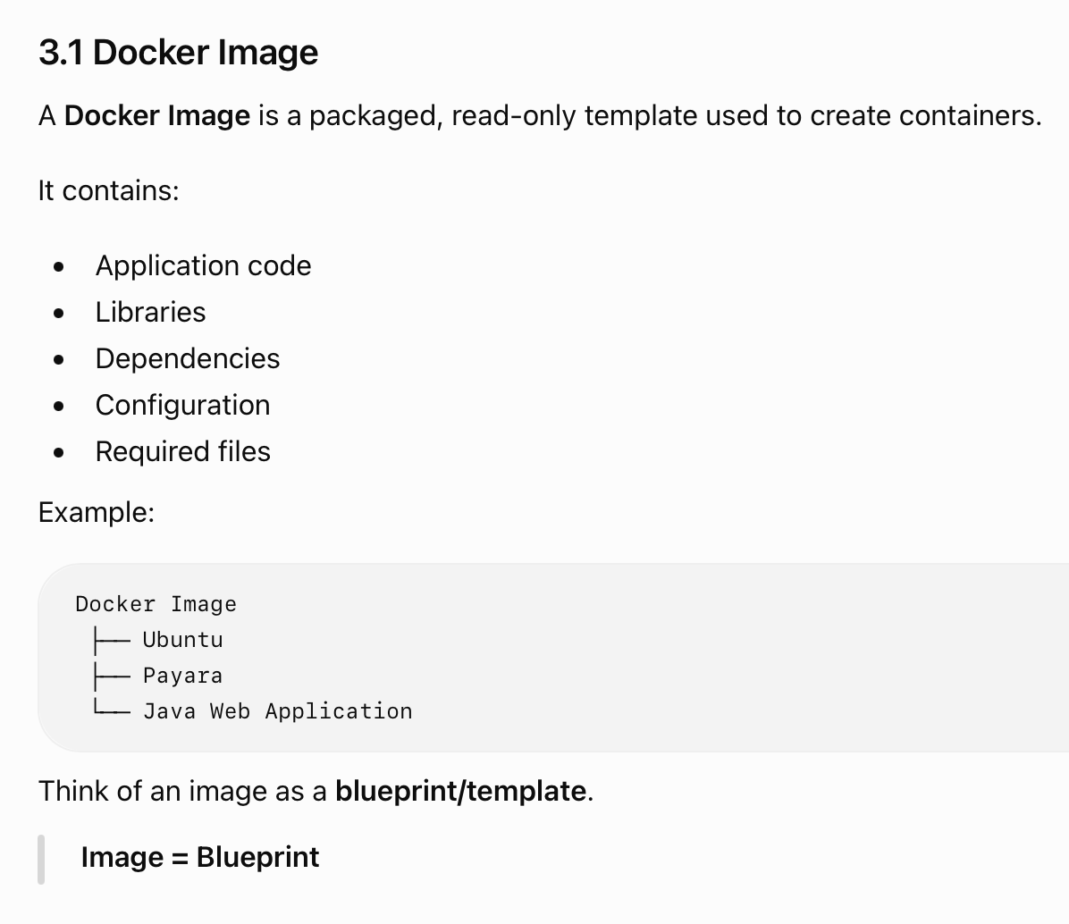

Slide 7
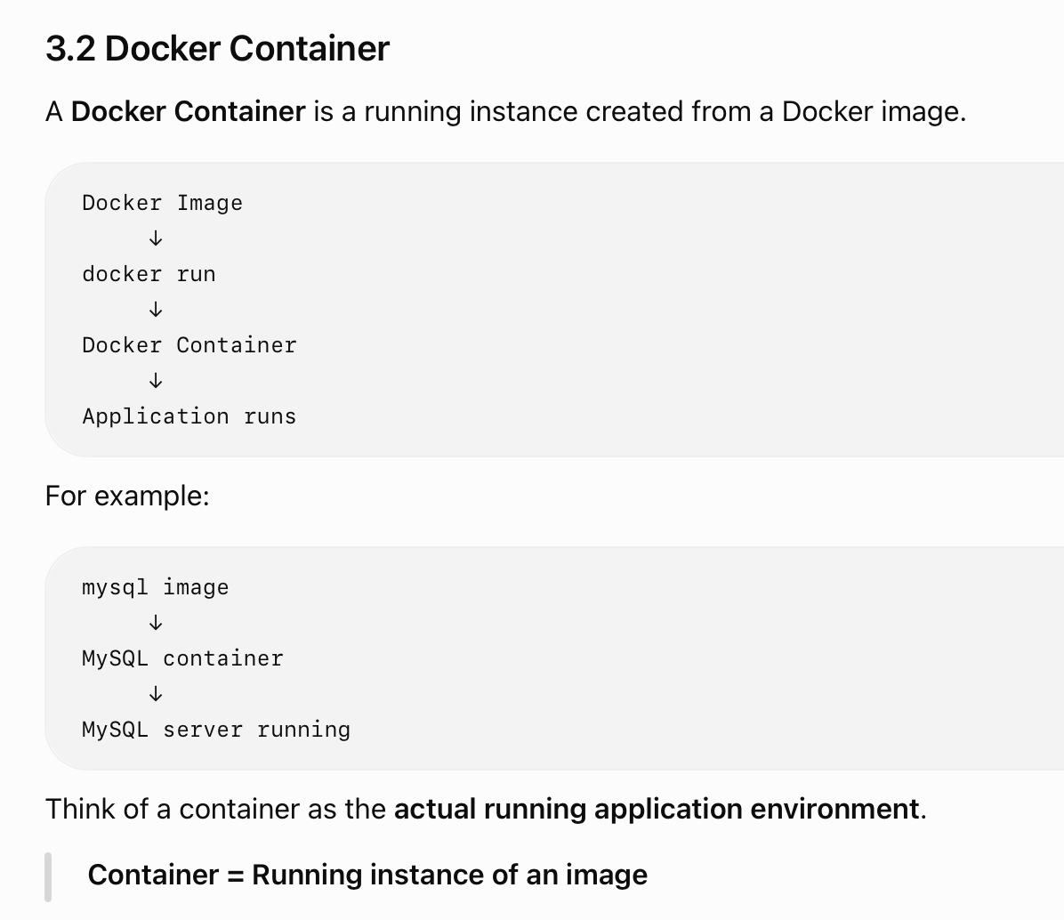

Slide 8
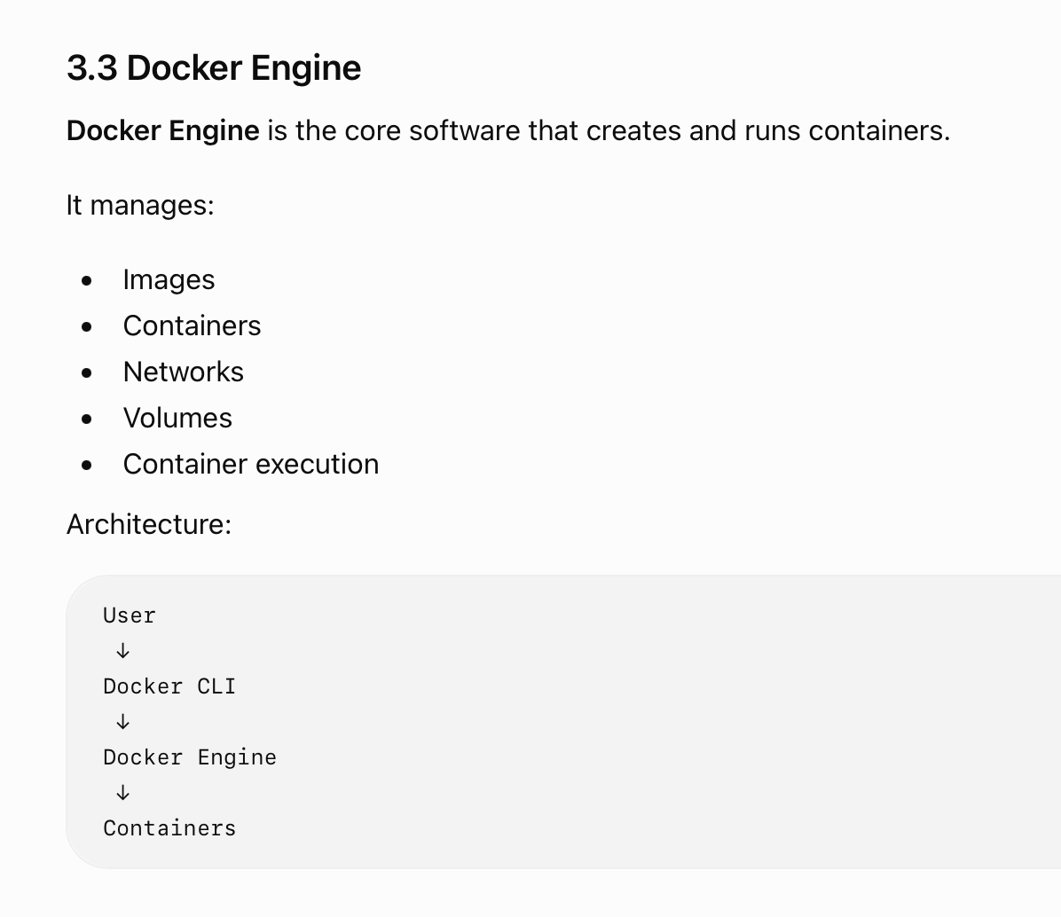

Slide 9
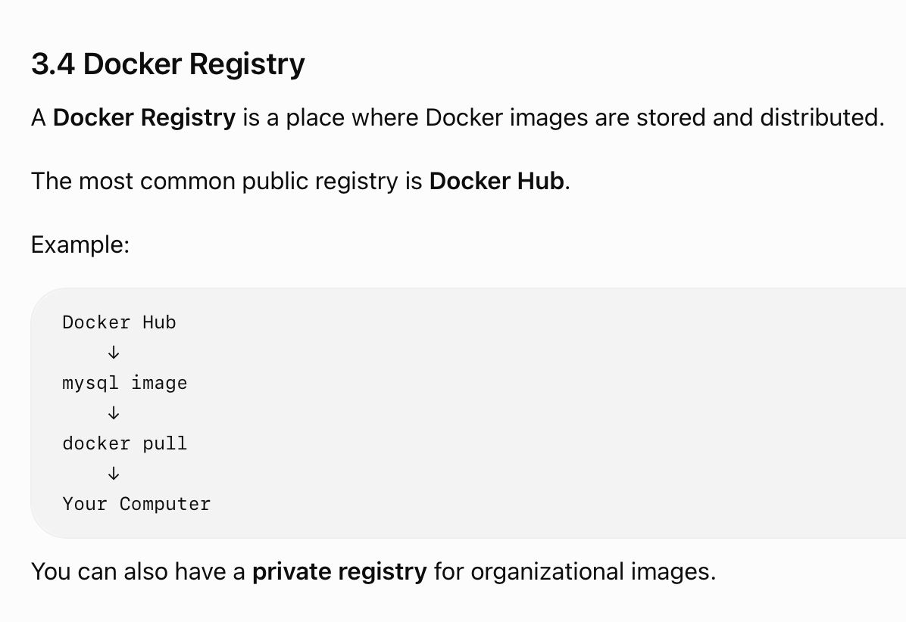

Slide 10
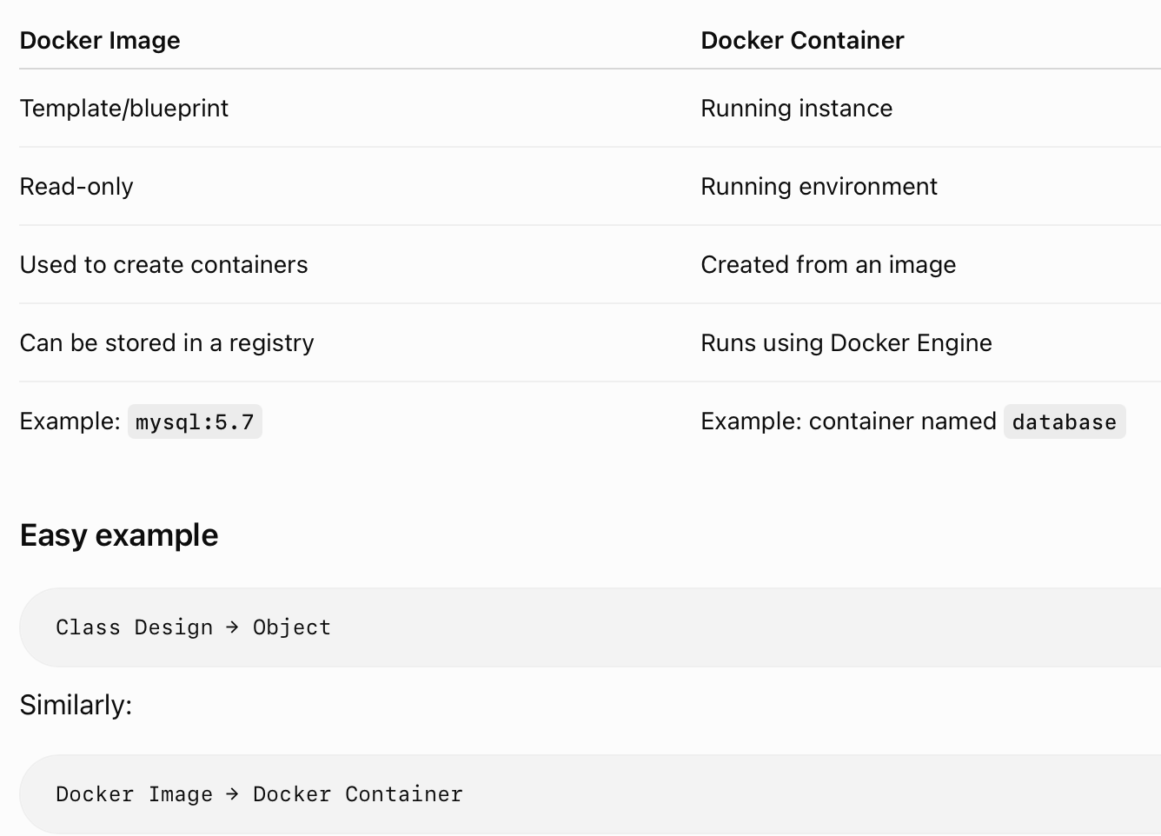
Comparision

Slide 11
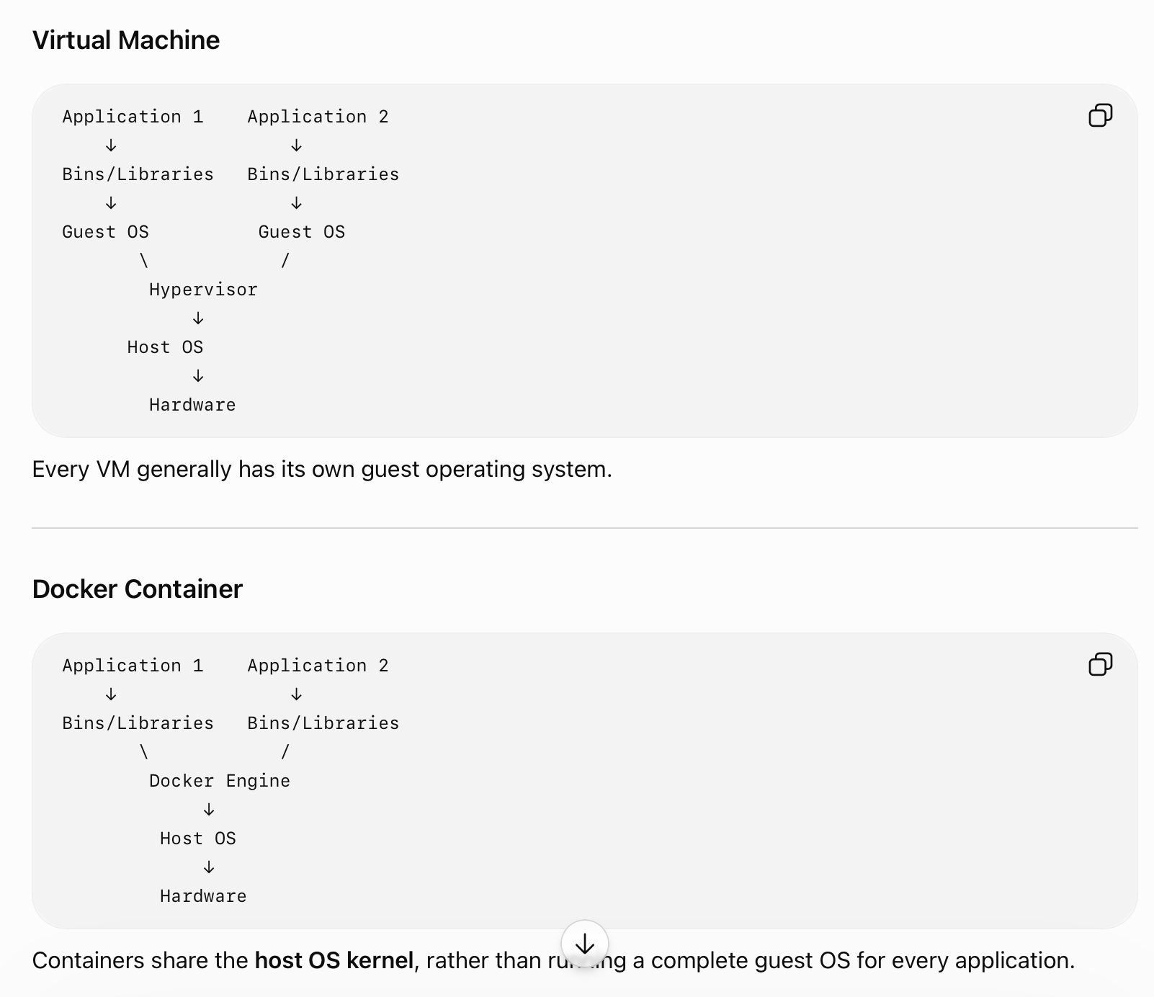
D Docker Container VS Virtual Machine
Main Difference
VM virtualizes hardware/complete operating systems, while containers isolate applications while sharing the host OS kernel.

Slide 12
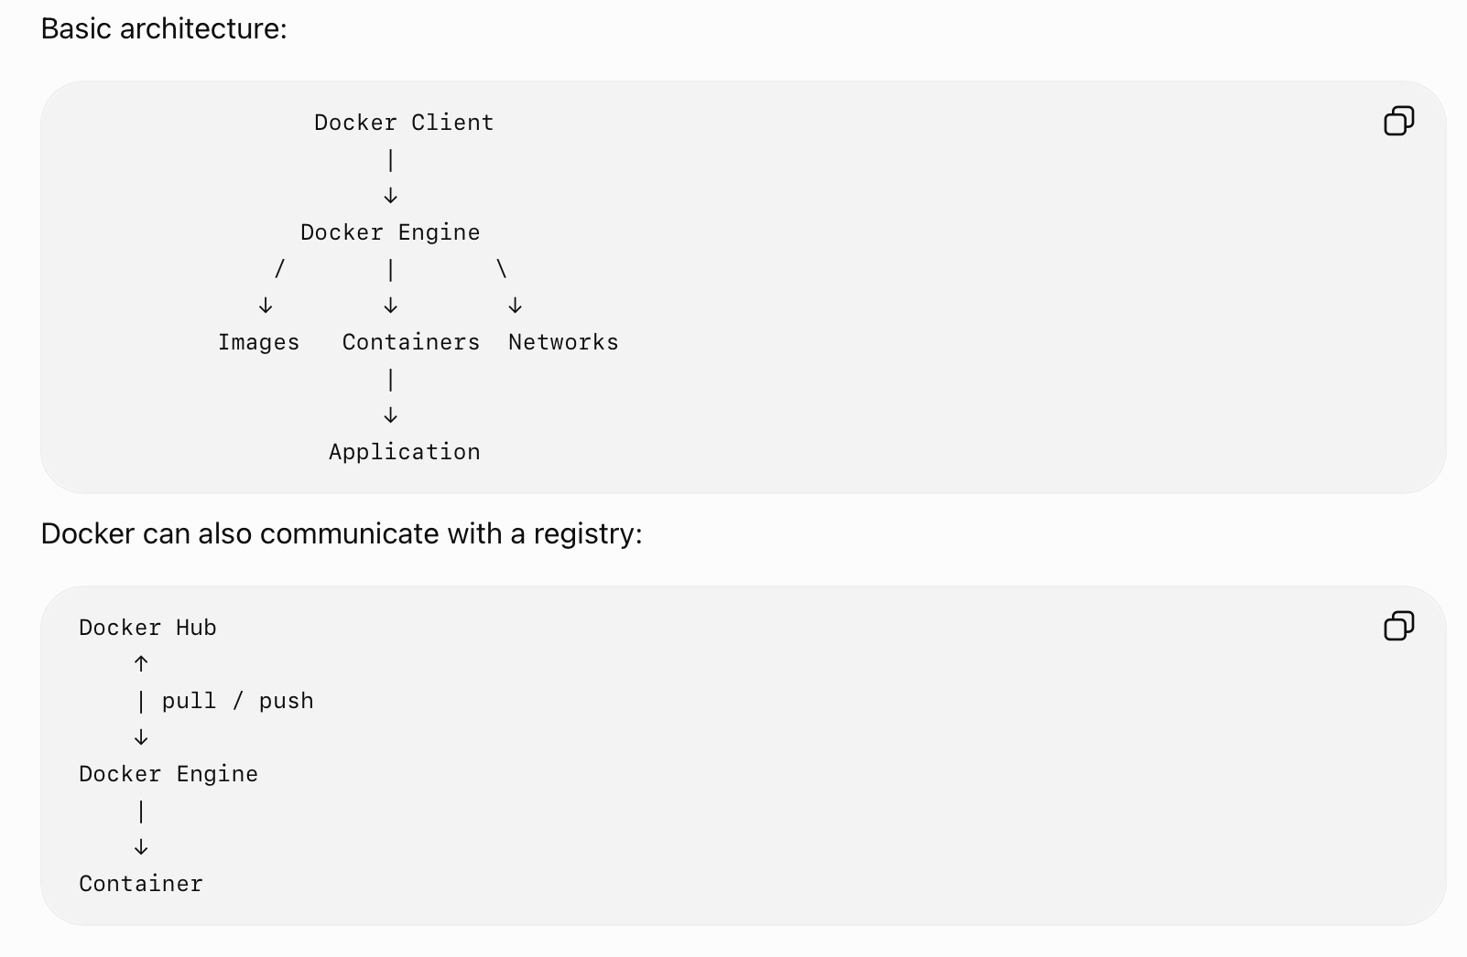
Docker Architecture

Slide 13
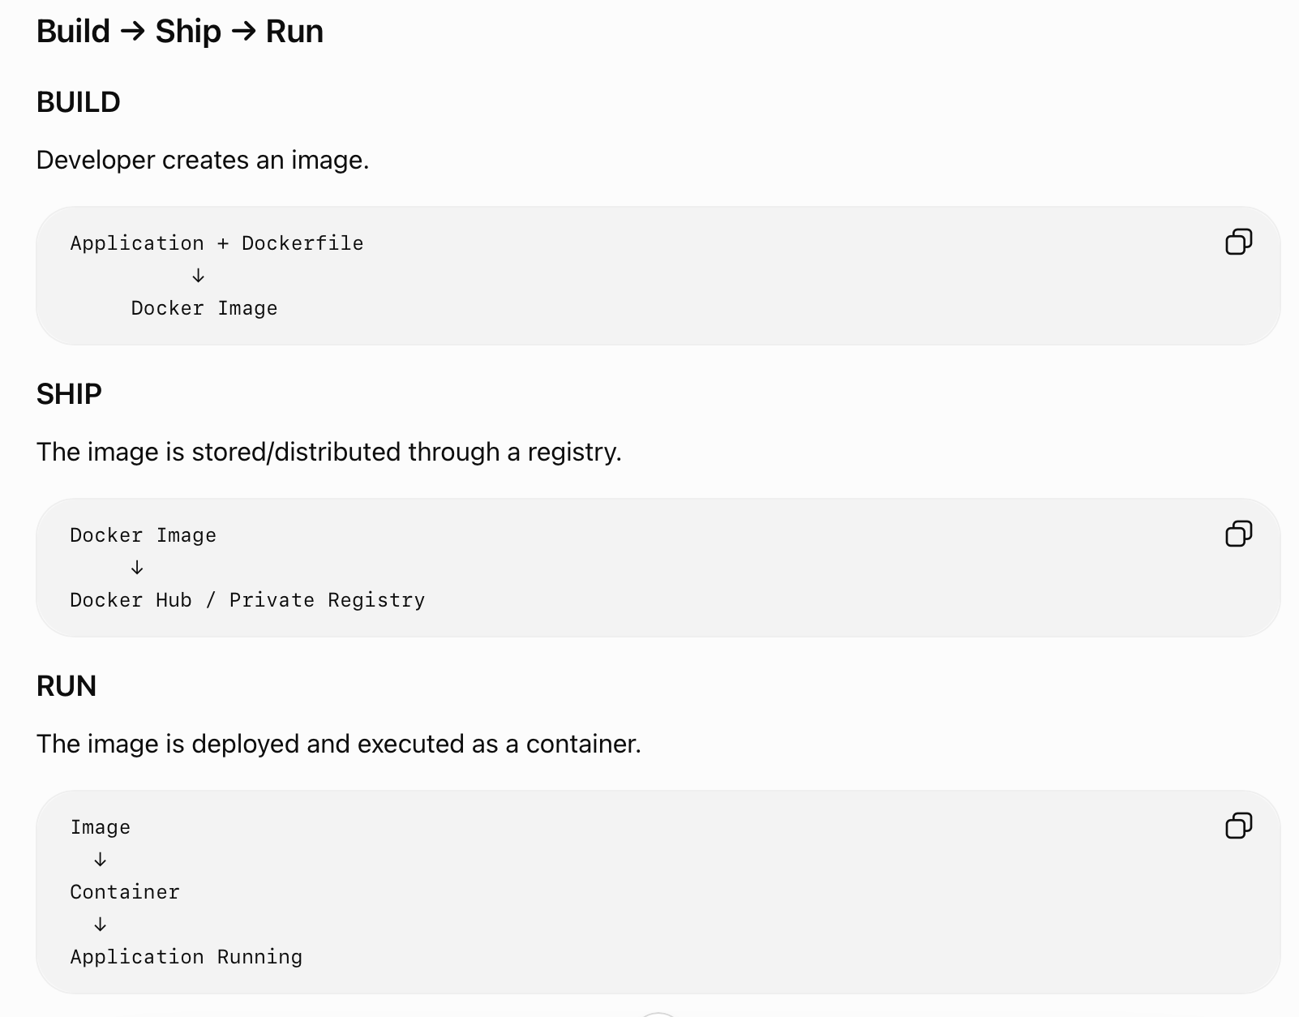
Docker Workflow

Slide 14
Docker Command
Practical Portion

Slide 15
Docker Commands
Installing Docker
sudo apt-get install docker-ce
Pulling an Image
docker pull mysql/mysql-server:5.7
docker pull <image_name>:<tag>
docker pull node:latest
Here:
node = image name
latest = tag/version label

Slide 16
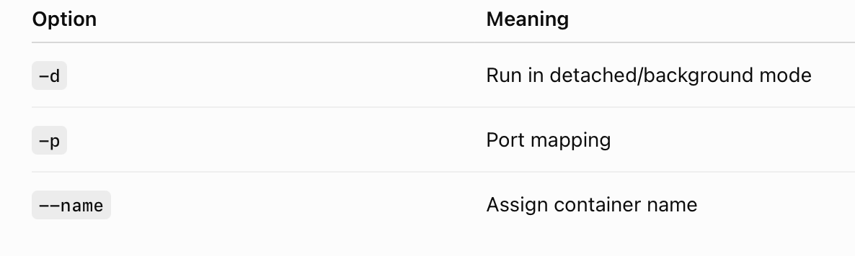
Docker Commands
List Docker Images
docker image ls
or
docker images
Running a Container
docker container run <image>
Example:
docker container run -d -p 5000:5000 --name node node:latest

Slide 17
Port Mapping - Docker Commands
Suppose an application inside the container runs on port 8080.
You want to access it through port 9070 on your computer.
docker run --name=web -p 9070:8080 mywebapp:1.0
Meaning:
Host machine Container
Port 9070 ─────────→ Port 8080
So you access: localhost:9070

Slide 18
Docker Commands
Checking Running Containers
docker container ps
To see all containers, including stopped ones:
docker container ps -a
Stopping a Container
docker container stop node
or:
docker stop node
From Container ID :
docker stop <container_id>
Removing a Container
docker container rm node
or
docker rm node

Slide 19
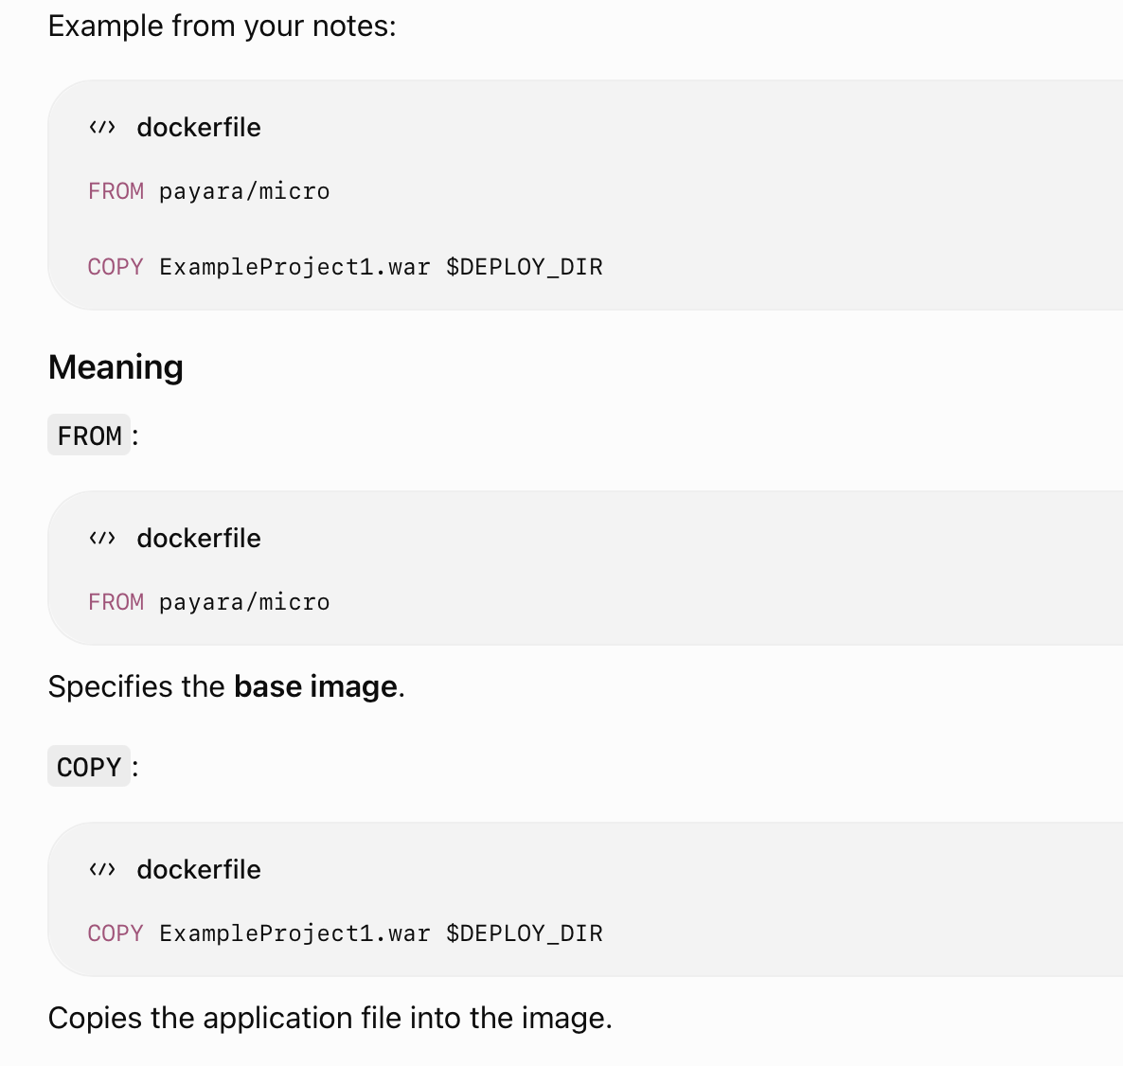
Docker Commands
Removing an Image
docker image rm node
or:
docker rmi node
Dockerfile
A Dockerfile is a text file containing instructions for building a Docker image.

Slide 20
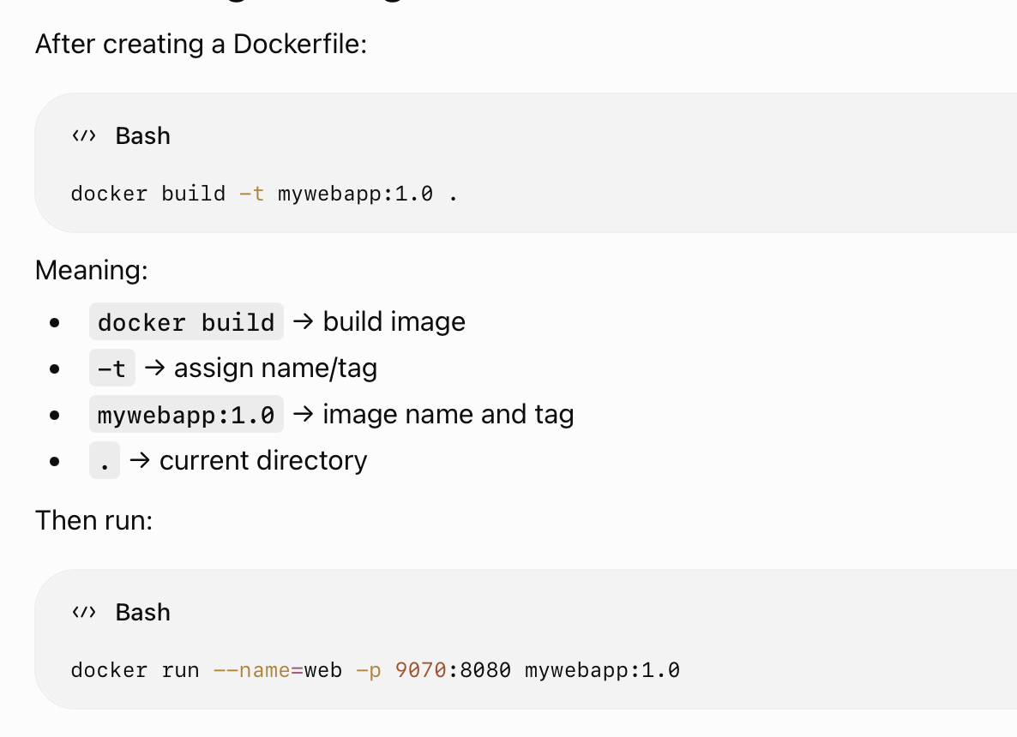
Docker Command : Building an Image

Slide 21
Additional Concepts
Small One’s

Slide 22
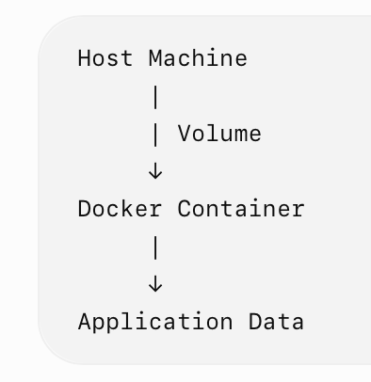
Docker Volumes
A Docker Volume is used to persist data outside the container's writable layer.
This is important because a container can be deleted, but application data may need to remain.
Why use volumes?
Persist data
Share data between containers
Store database data
Keep data even after container deletion
Mount source code into containers
Example :
docker run -v /home/data:/var/lib/mysql mysql

Slide 23
Meaning of Above Example
Host:
/home/data
↓ mounted to
Container:
/var/lib/mysql

Slide 24
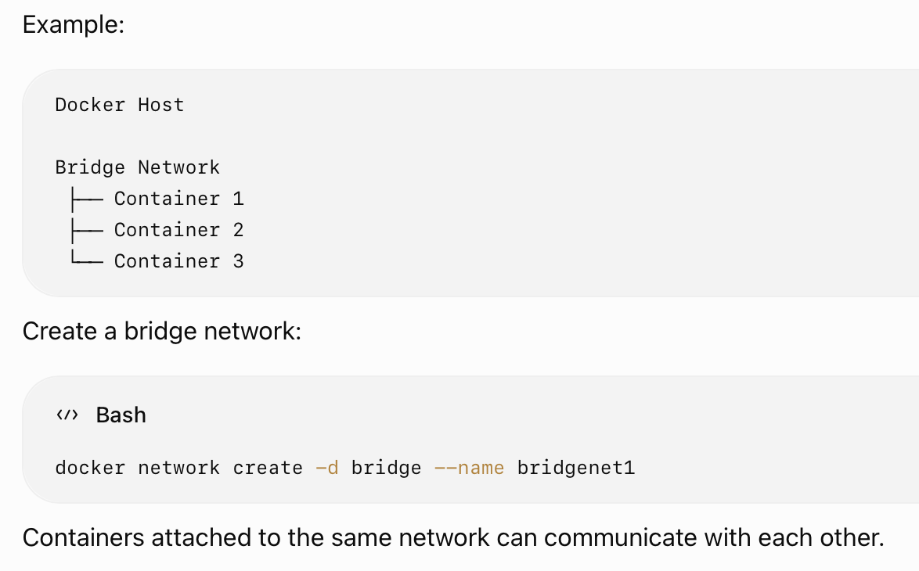
Docker Networking
Docker containers can communicate using Docker networks.
A bridge network is a common Docker network type.

Slide 25
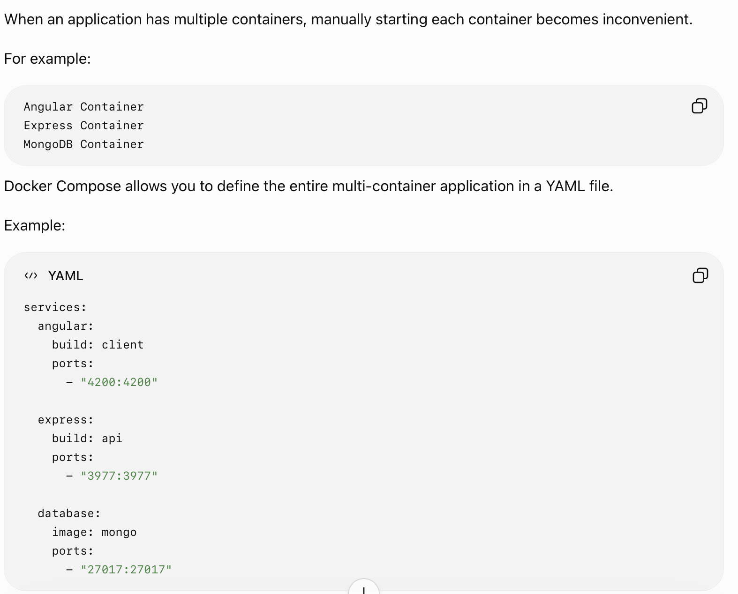
Docker Compose

Slide 26
Deploying MySQL on Docker - 2 Marks
Step 1: Pull MySQL image
docker pull mysql/mysql-server:5.7
Step 2: Run MySQL container
Host Machine
localhost:3406
|
↓
Docker Container
MySQL :3306
|
↓
/var/lib/mysql
|
↓
Persistent Volume

Slide 27
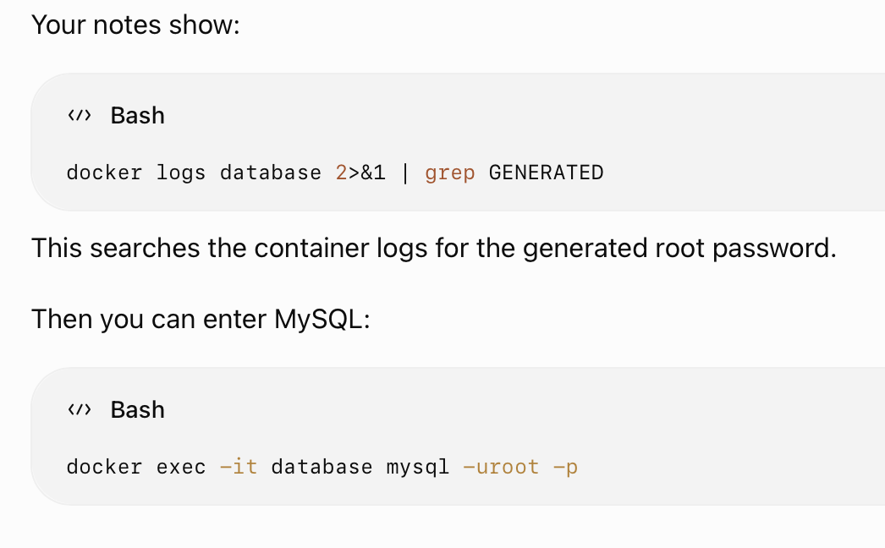
Get MySQL Container Logs

Slide 28
docker exec
docker exec allows you to execute a command inside a running container.
Example:
docker exec -it database mysql -uroot -p
Meaning:
exec → execute command
-i → interactive
-t → terminal
database → container name
mysql -uroot -p → MySQL client command

Slide 29
Stop and Remove MySQL Container
Stop:
docker stop database
Remove:
docker rm database
Creating Your Own MySQL Image :
ROM mysql/mysql-server:5.7
ENV MYSQL_DATABASE=test
ENV MYSQL_ROOT_PASSWORD=yourpassword
COPY mydata.sql /docker-entrypoint-initdb.d/
COPY grant.sql /docker-entrypoint-initdb.d/

Slide 30
Docker Demon
The Docker Daemon (dockerd) is the background service of Docker that manages the lifecycle of Docker containers.
It continuously runs in the background and receives requests from the Docker Client.
Container Lifecycle Management
The Docker Daemon manages all major stages of a container's lifecycle:
Docker Client
│
│ Commands
▼
Docker Daemon (dockerd)
│
├── Create Container
├── Start Container
├── Stop Container
├── Restart Container
├── Remove Container
└── Manage Container Resources

Slide 31
Example:
When you run:
docker run -d nginx
The Docker Client sends the request to the Docker Daemon. The daemon then:
Finds/pulls the nginx image if required.
Creates a container from the image.
Allocates required resources.
Starts the container.
Monitors and manages the running container.

